Slide 1



SUSTAINABLE AND ECO-FRIENDLY PRODUCTS
Sustainable Living
BY GROUP 5
UNDER THE SUPERVISION OF PROF. SOMA HAZRA

Slide 2


CONTENTS
03/
Introducing Green Cart
01/
Introduction
04/
The Green Cart Experience
02/
Pollution from Daily Products
07/
Our Tech Stack
05/
Green Tour
08/
Future Enhancements
06/
Eco Friendly vs Sustainable

Slide 3

Isn't it Getting Hotter?
Have you noticed how each summer feels hotter than the last?
Global temperatures are rising at an alarming rate. But why?
The primary cause is global warming, driven by human activities such as pollution and deforestation.
We can all feel the impact: more frequent heatwaves, rising sea levels, and unpredictable weather patterns.

Slide 4
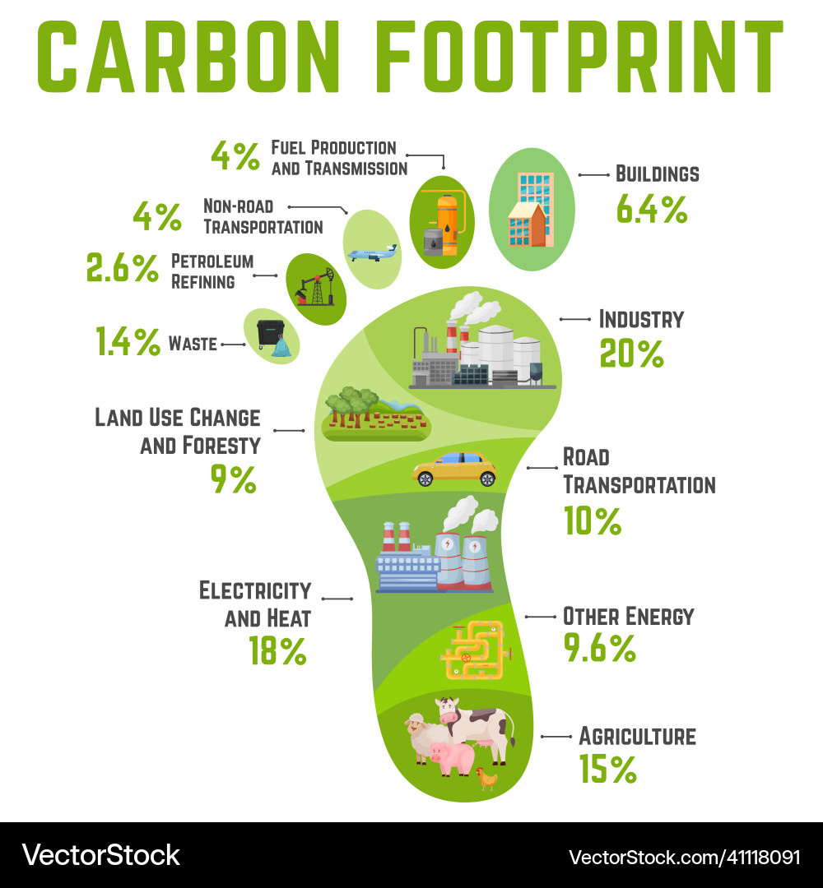
Pollution from Daily Products
"Our everyday products, from plastic bottles to fossil fuels, contribute significantly to environmental pollution."
"These products release harmful chemicals and greenhouse gases into the environment, exacerbating global warming."
"Plastic waste clogs our oceans, harming marine life, while fossil fuel emissions contribute to air pollution and climate change."

Slide 5
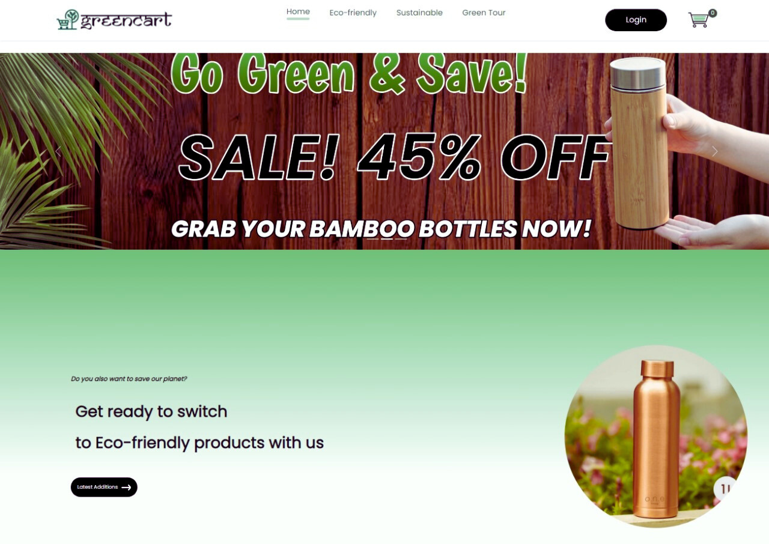
Introducing GreenCart
Green Cart is an e-commerce platform focused solely on sustainable and eco-friendly products."
Unlike major e-commerce giants like Flipkart, Amazon, Alibaba, etc. which offer an overwhelming variety of products, Green Cart provides a curated selection aimed at reducing negative impact on environment.

Slide 6
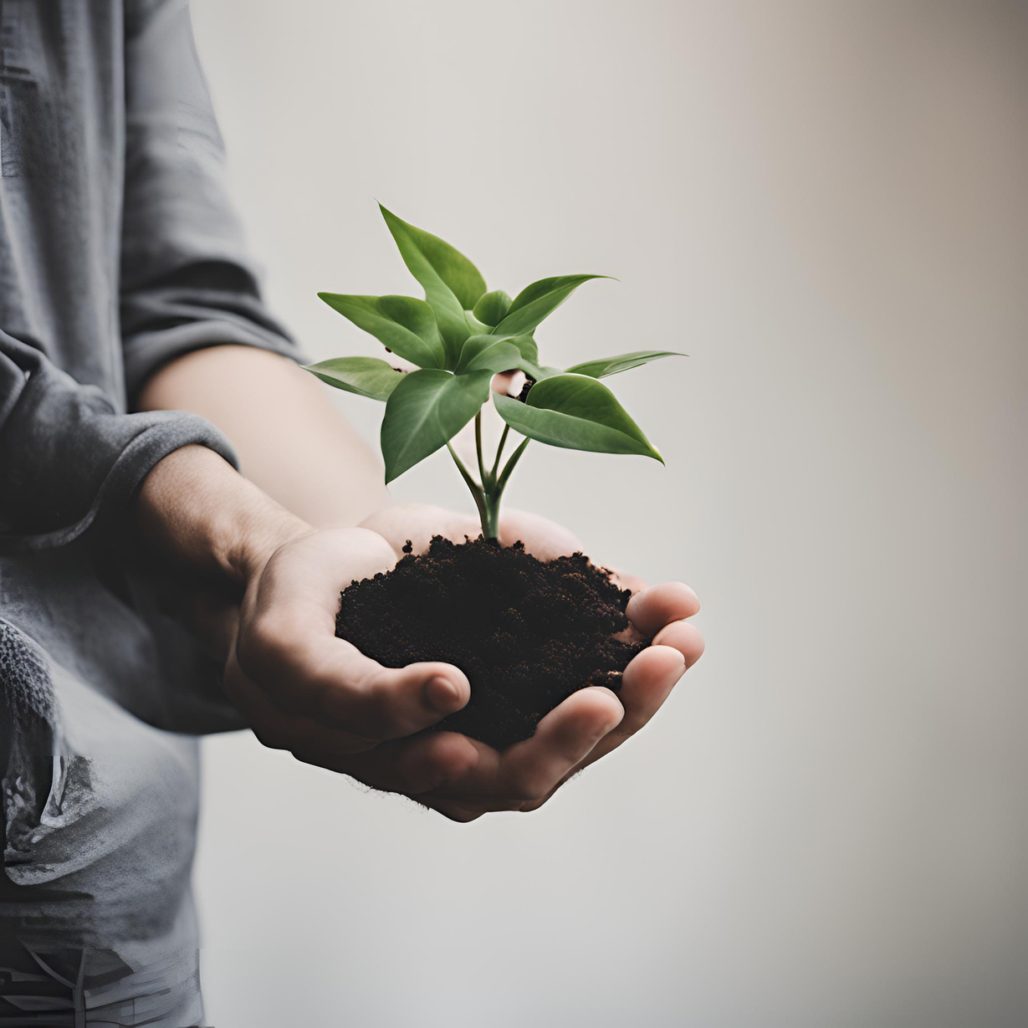
WHAT GREENCART DOES BETTER
Feature | GREENCART | Others
Product Selection | Curated, sustainable products | Overwhelming variety
Educational Resources | Blogs & guides | Focus on sales
Sustainability | 100% sustainable | Minimal sustainable options
Shopping Experience | Streamlined, focused | Distracting, aggressive marketing

Slide 7
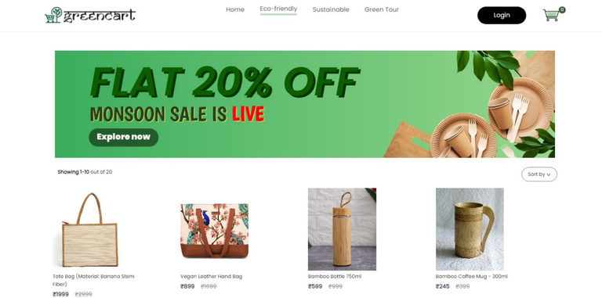
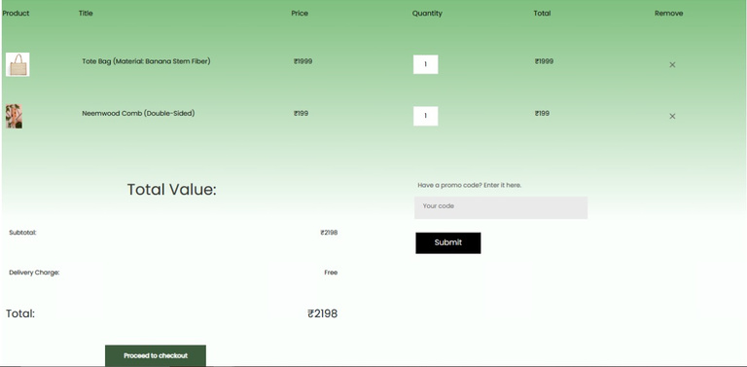
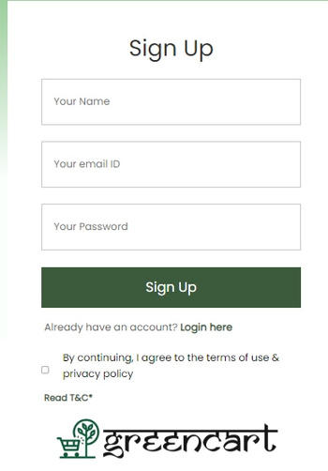
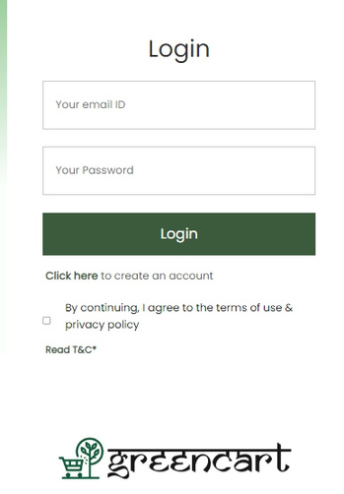
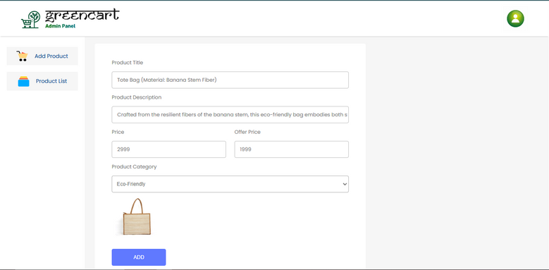
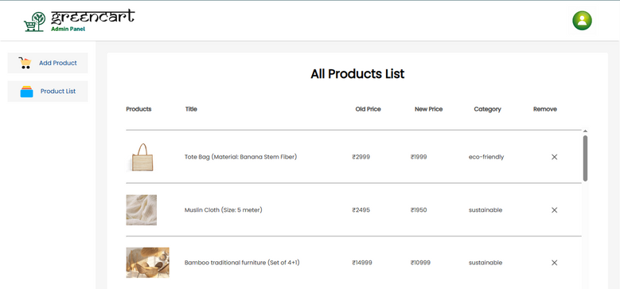
The GreenCart Experience
Our website offers a seamless user experience designed to promote sustainability.
Key features include an easy-to-navigate menu, various product categories, simple login and signup processes, and a streamlined cart functionality.
Menu: Intuitive and easy to navigate.
Categories: Clear and focused on sustainability.
Login/Signup: Simple and quick process.
Cart: Seamless checkout experience.

Slide 8
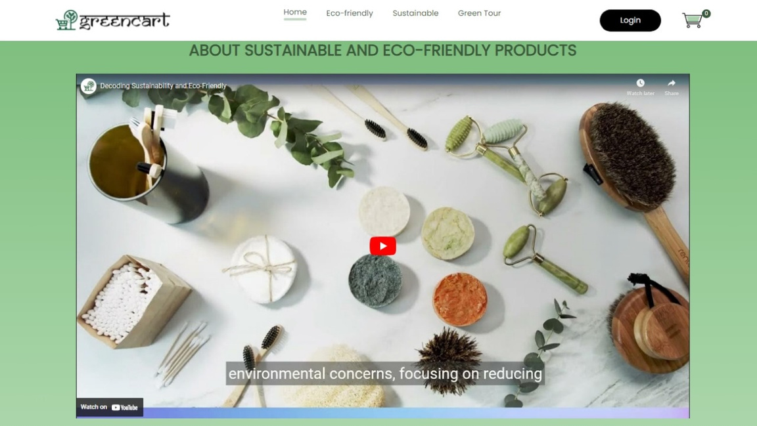
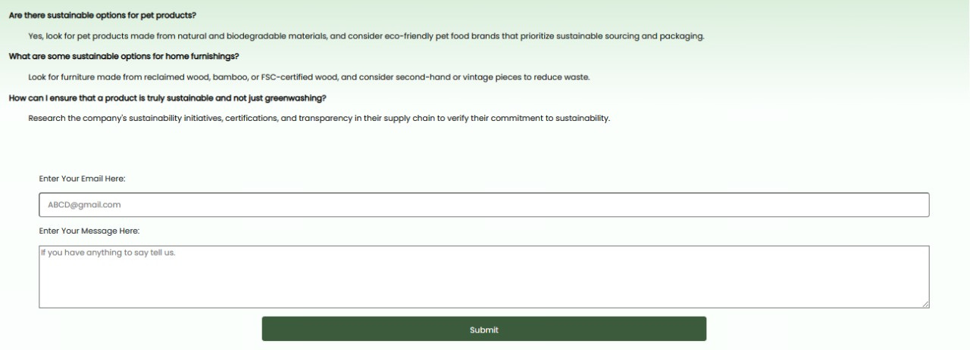
Green Tour
Help

Slide 9


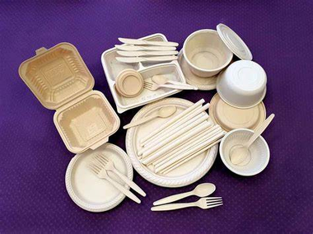

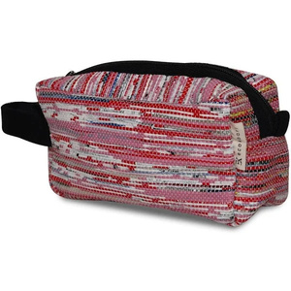

ECO FRIENDLY
vs
SUSTAINABLE
ECO FRIENDLY
SUSTAINABLE
Eco-friendly products are designed to reduce immediate environmental harm during production, use, and disposal.
Sustainable products, on the other hand, consider the entire lifecycle, from raw material extraction to end-of-life disposal, ensuring long-term ecological balance and ethical sourcing.

Slide 10
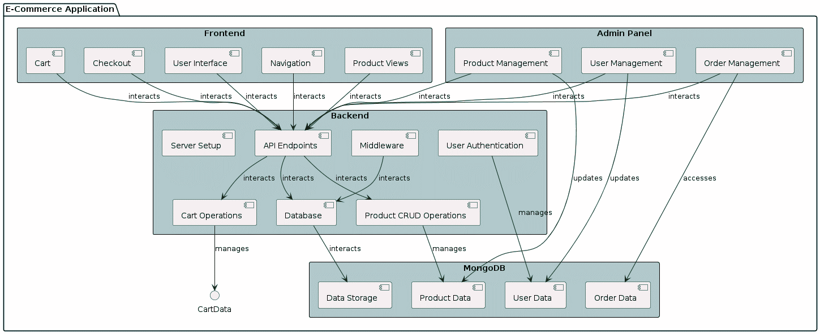
HOW IT WORKS!

Slide 11



TECH STACK USED
Mongo DB
React
React
Bootstrap
DATABASE
FRONTEND
FRONTEND DESIGN
Express
Node JS
BACKEND
ENVIRONMENT

Slide 12

Future Enhancements
AI-recommendation system and chat-bot
Customer verification
Review system
Credit & Rewards System

Slide 13




WHO WE ARE
Soumyajit Nag
Anirudh Jalan
Srijan Singh
Ishita Ghosh

Slide 14

Thank you very much!

